Slide 1

US National Parks Recreation Visits Analysis and Machine Learning Approach
Data Viz Championship
Ryo Hasegawa

Slide 2
Abstract
Objective: Analyze U.S. National Parks' recreation visit trends and develop a predictive model for visit counts
Dataset: Recreation visit data from 1979 to 2023, categorized by parks, states, and regions
Modeling Approach:
Used Linear Regression to derive an interpretable model equation.
Predicted recreation visits based on year, region, and state features.
Business Insights: Idea using the visualization and Modeling Approach

Slide 3
Visualizations
Total Recreation Visits by Region Over Time
Top Parks by Total Recreation Visits
Regional Share of Recreation Visits

Slide 4
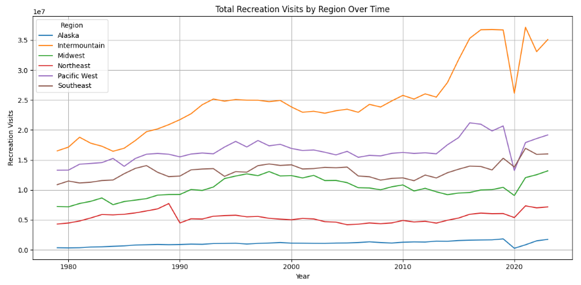
Total Recreation Visits by Region Over Time
Observation
Slight increase in 2013-2017
Huge decrease in 2020
Analysis
Centennial Celebration of the National Park Service (2016)
Increase of share of Social Media
Coronavirus Shock in 2020

Slide 5
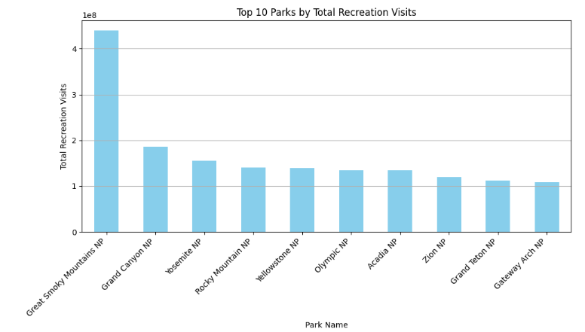
Top Parks by Total Recreation Visits
Observation
Great Smoky Mountains, Grand Canyon, and Yosemite takes top 3
Analysis
Except for the Great Smoky, there are no large difference in the Total Recreation Visits
Park-specific factors had minimal impact on total visit trends.

Slide 6
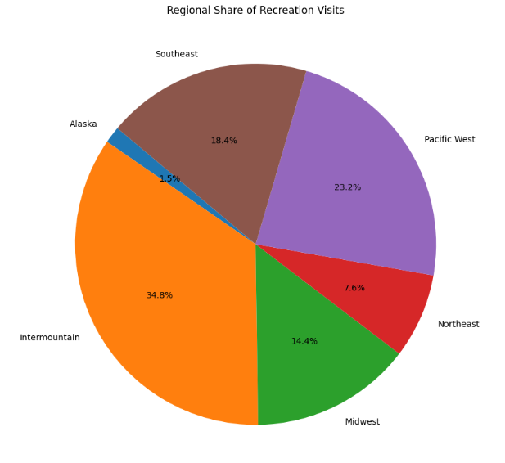
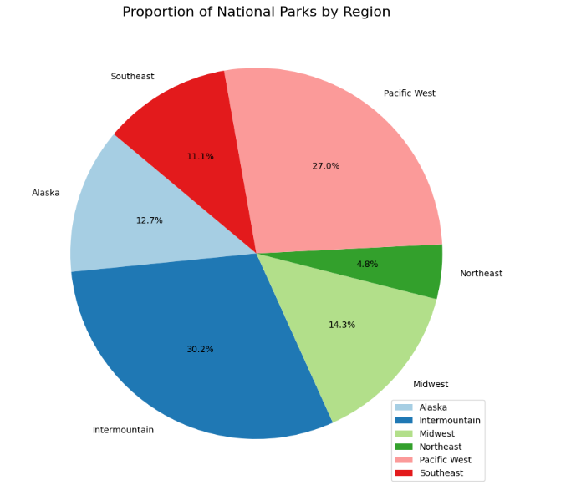
Top Parks by Total Recreation Visits
The main difference are Alaska , Intermountain and Southeast
Tourists travels Alaska for Visiting National Parks

Slide 7


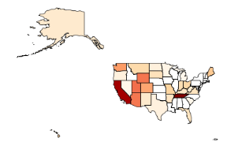
Top Parks by Total Recreation Visits
Observation
Tennessee and California show notable advantages
Alaska has recorded lower figures than anticipated
Analysis
California has the most National Parks.
Tennessee hosts the most visited National Park, the Great Smoky Mountains.
Business Opportunity

Slide 8
Prediction/Machine Learning
Predictive Equation
Residual Plot
Scatter Plot

Slide 9
Predictive Equation
RecreationVisits = -14271179.50 + 7323.90*Year + 155197.60*Region + 35946.39*State
Assumptions:
Visitation shows an increasing trend over the years.
Regional effects outweigh state-specific impacts.
Social media platforms (e.g., Instagram) drive interest in specific scenic locations rather than broader areas.

Slide 10
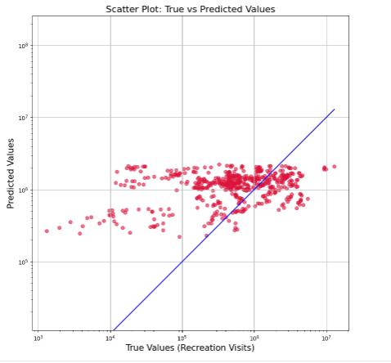
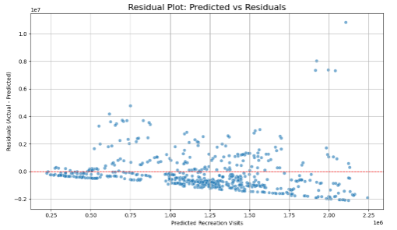
Residual Plot and Scatter Plot
Visitation trends align closely with predictions.
Positive deviations occur where actual visits exceed expectations.

Slide 11

Business Insights:
We can predict the number of visiting to NP increases overtime Except the rare case such as coronavirus
Social media has the tremendous power nowadays.
Idea: Campaign that collabs with other industries that adds values to visit Np would be effective: Sports Brand, Drink Brand
They can approach to social media user by adding experience/purpose for visiting

Slide 12
Thank you!
Ryo Hasegawa
https://www.linkedin.com/in/ryo-hasegawa-5b078a292/

